Slide 1
Eco Drive: Eco Drive Goal
PIP2001 Capstone Project
FINAL REVIEW
Batch Number:Group-09
Under the Supervision of,
Dr. Ananda Raj S P
Professor&HOD(CCS,CIT)
School of Computer Science and Engineering
Presidency University
Roll Number | Student Name
20211CIT0073 | R K RAGA MANASA
20211CIT0118 | DARSI SAI SHASHANK
20211CIT0029 | GUDA VAMSI REDDY
20211CIT0171 | SHAIK SALMAN
20211CIT0016 | KANCHAM ABHINAY REDDY
Name of the Program: BTECH-CSE(IOT)
Name of the HoD: Dr. Anandaraj S P
Name of the Program Project Coordinator: Dr. Sharmasth Vali Y
Name of the School Project Coordinators: Dr. Sampath A K / Dr. Abdul Khadar A / Mr. Md Ziaur Rahman

Slide 2
Introduction
Eco Drive is a mobile application designed to help users reduce their carbon footprint by tracking and analyzing their travel behavior.
The app encourages sustainable commuting practices such as carpooling, cycling, and public transportation to minimize emissions.
It incorporates gamification elements, such as rewards, badges, and leaderboards, to motivate users to adopt eco-friendly travel habits.
By fostering community engagement, EcoDrive allows users to compete with friends and family to achieve collective sustainability goals, making environmental impact reduction both engaging and socially interactive.

Slide 3
Literature Review
Author(s) | Year of Publish | Paper Name | Key Points | Merits | Demerits
Chopra, D. & Arora, V. | 2024 | "Reducing Urban Emissions via Mobile Technologies" | Investigates the role of mobile technologies in reducing urban carbon emissions through sustainable commuting. | Provides evidence of a significant reduction in emissions with the use of mobile tracking and carpooling apps. | Does not deeply explore user retention strategies or gamification features.
Smith, J. & Nguyen, T. | 2023 | "Behavioral Impact of Real-Time Carbon Data in Transport Apps" | Studies the behavioral impact of real-time feedback on users' carbon footprint in transport-related apps. | Shows that real-time data leads to immediate changes in travel behavior, such as opting for public transport. | Limited focus on long-term engagement and the role of social/community features.
Silva, M. & Clark, A. | 2022 | "Sustainability through Community-Driven Initiatives" | Discusses how community engagement enhances sustainability efforts, including in transportation | Highlights the benefits of community-based solutions for environmental impact reduction. | Does not integrate gamification, which could further drive engagement.
Gopalakrishnan, S. | 2021 | "Smartphone Applications for Sustainable Transport" | Discusses how mobile apps can help users adopt eco-friendly transportation habits using real-time data. | Provides a framework for integrating real-time commute tracking. | Limited user engagement strategies, lacks community-oriented features.

Slide 4
Existing method Drawback
Manual Data Entry
Limited Real-Time Feedback
Lack of Community Engagement
Poor Gamification Features ​
.

Slide 5
Proposed Method
Automated Carbon Footprint Tracking
Real-Time Feedback and Insights
Gamification for User Engagement
Community-Based Approach

Slide 6
Objectives
Automate Carbon Footprint Tracking
Promote Sustainable Travel
Engage Users Through Gamification
Foster Community and Collective Action

Slide 7
System Design and Implementation
Step 1: User Sign-up
Step 2: Data Collection
Step 3: Carbon Footprint Calculation
Step 4: Gamification Engine
Step 5: Neighborhood Engagement
Step 6: Carbon Footprint Reporting & Feedback
Step 7: Notifications & Incentives

Slide 8
Methodology/Modules
Commute Data Collection Module
Carbon Footprint Calculation Module
Gamification Module
Community and Social Module

Slide 9
Hardware/software components
HARDWARE:
Smart Phones
Server
Internet Connectivity
SOFTWARE:
Mobile Application
Back End
Cloud Infrastructure
Security Protocols

Slide 10
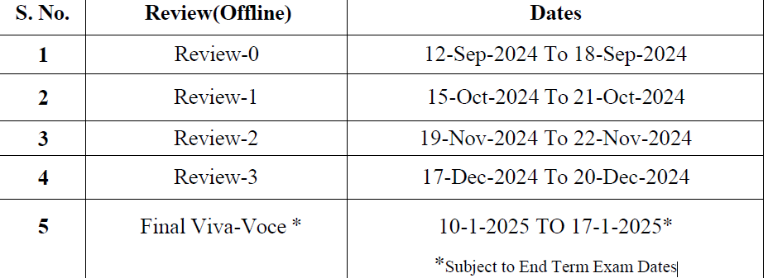
Timeline of Project

Slide 11
Expected Outcomes
Reduction in Carbon Emissions
Enhanced User Engagement
Community Awareness and Collaboration
Data-Driven Insights for Policy Making

Slide 12
Conclusion
In conclusion, the EcoDrive project offers a comprehensive solution to the growing problem of vehicle emissions and air pollution by promoting sustainable commuting practices. Through automatic tracking of carbon footprints, gamification for user engagement, and a community-centered approach, the app aims to motivate individuals and groups to reduce their environmental impact. The anticipated outcomes include a reduction in emissions, increased awareness, and valuable data for policymakers. EcoDrive merges technology, social collaboration, and sustainability in an innovative way, contributing to a greener future.
"Small acts, when multiplied by millions of people, can transform the world." – Howard Zinn

Slide 13
Github Link
Github Link
https://github.com/Manasa11166/CITG9-CAPSTONEPROJECT.git

Slide 14
References
• Jain, A., Gupta, S., & Desai, N. (2020). "Understanding Carbon
Footprint Reduction: A Study on Transportation Choices." International
Journal of Sustainable Transportation, 14(2), 120-130.
• Sharma, R., & Singh, A. (2021). "Gamification in Environmental
Sustainability: Motivating Sustainable Behavior." Journal of Environmental
Management, 270, 110870.
• Kumar, P., & Singh, V. (2019). "Community Engagement in
Environmental Initiatives: A Study on the Impact of Social Networks."
Sustainable Cities and Society, 45, 547-556.
• Patel, R., & Agarwal, S. (2022). "Securing User Data in Mobile
Applications: A Comparative Analysis of OAuth 2.0 and Other Protocols."
Journal of Cybersecurity and Privacy, 2(3), 345-356.

Slide 15
Project work mapping with SDG
SDG 11: Sustainable Cities and Communities
SDG 12: Responsible Consumption and Production
SDG 13: Climate Action
SDG 17: Partnerships for the Goals

Slide 16
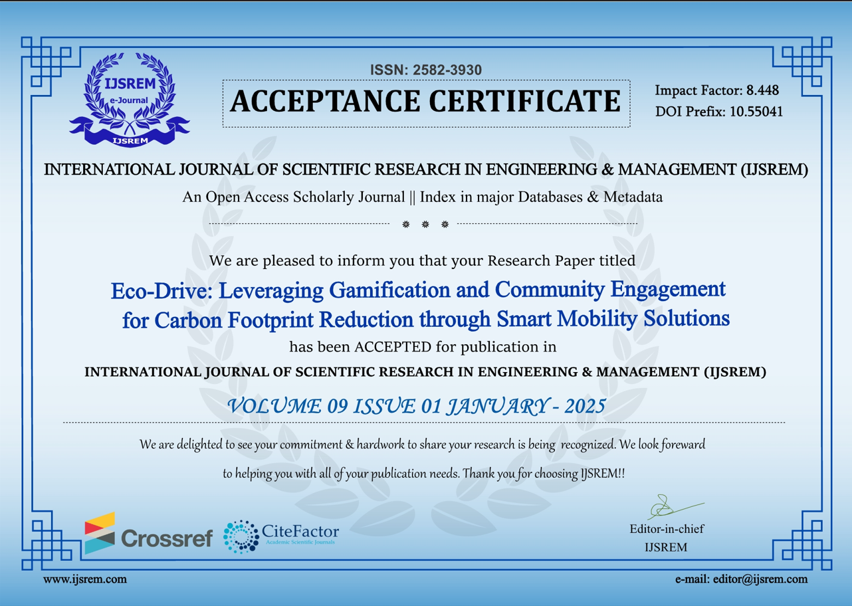
PAPER PUBLICATION

Slide 17
Thank You

